Slide 1

Project Title: Robot Path Finding
BY:
AYYAN BABAR (19L-0903)
NAFEESA ARIF (19L-1212)

Slide 2
OVERVIEW
05. Analysis & Experimentation
06. Conclusion
07.
02. Data Structures Used
03. Algorithm Involved
04. Implementation
01. Introduction

Slide 3
—SOMEONE FAMOUS
“This is a quote, words full of wisdom that someone important said and can make the reader get inspired.”

Slide 4
01
INTRODUCTION

Slide 5

INTRODUCTION
Robot Path finding by providing the source and destination aims at finding the shortest optimal distance
A possibility of multiple paths from source and destination.
Walls/obstacles created manually, and the path is chosen which is the shortest of all the paths i.e., the cost is least.

Slide 6

02. Data Structures Used

Slide 7
The data structures used are as follows:
Queues
Priority Queues
Linked List
Graph

Slide 8
Data Structure | Usage
Queues
Priority Queues
Linked List
Graph

Slide 9
03
ALGORITHM INVOLVED

Slide 10

The Two Algorithms are:
Dijkstra’s Algorithm
A* Algorithm
refinement to the shortest path algorithm that directs the search towards the desired goal from the initial vertex.
a heuristic function f(n)=h(n)+g(n), that estimates how far a given vertex v is from the goal vertex,
h(n) is an estimate of the minimum cost from any vertex n to the goal
g(n) is the cost of moving from the initial cell to the current cell.
Dijkstra's algorithm greedily visits nodes in order of increasing distance from the initial vertex.
time in exploring nodes = time in opposite direction from the desired goal.
It expands almost radially.
when h(n) and g(n) become equal, the A* algorithm becomes Dijkstra’s algorithm.

Slide 11
04. IMPLEMENTATION

Slide 12
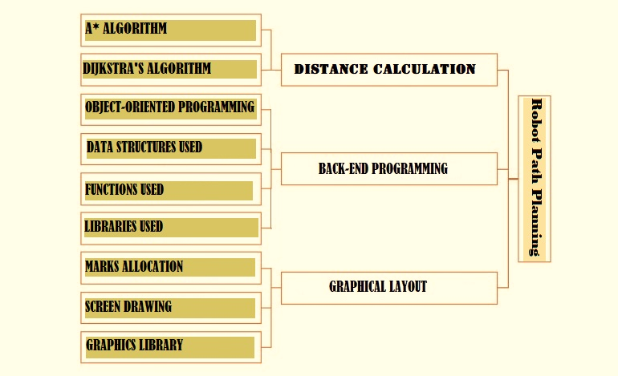
Implementation Design

Slide 13
OnUserCreate
Functions Used
Heuristic
Refresh
OnUserDelete
importing
OnUserUpdate
Creates the board
Calculation of Euclidean distance
Refreshes the board
visualdistance
exporting
A_star
Works if h(n)=g(n) in f(n)
Writing on the file
Heuristic distance calculation implementaion
Empties close list until not emptied
Reading from a file
Main function

Slide 14
05
ANALYSIS & EXPERIMENTATION

Slide 15

Algorithm | Feasibility
Depth-first Search | The algorithm was not suitable as it did not return the optimal path but returns the path from which the goal is reached first.
Breadth-first Search | This algorithm also failed as it did not return the desired output. It does not tell how far the path has been crossed and how far the goal is.
A* | It calculates heuristic function's value at each node on the work area and involves the checking of too many adjacent nodes for finding the optimal solution with zero probability of collision.
Dijkstra | This algorithm found the shortest optimal path by calculating the distance to each unvisited node.
___

Slide 16
data structures Used | alternative | Comparison
Queues | Stacks | Since priority was to be considered, priority queue was more favorable than stacks as stacks only allow the topmost element to be extracted.
Graphs | Array | Graphs can be expanded and are dynamic as used using linked list, while arrays cannot be expanded as are static
Name | alternative | Comparison
Euclidean Distance | Manhattan Distance | Euclidean distance is the length of the segment between two points whereas Manhattan distance is the sum of distances of all dimensions
Game Console Engine | SFML | Game Console Engine visualizes better than SFML and operates faster.

Slide 17
06. CONCLUSION

Slide 18
tt
tt
tt
tt
tt
tt
tt
tt
tt

Slide 19
0
0
0
tt
tt
tt

Slide 20
tt
tt
tt
tt
tt
tt
tt

Slide 21
0
tt

Slide 22
tt
 | tt | tt
tt | tt | tt
tt | tt
tt |  |  | tt

Slide 23
tt
tt
tt
tt

Slide 24
PROGRAMMING TIMELINE
tt
tt
tt
tt
1991
2007
2008
2014
tt
tt
tt
tt

Slide 25
tt
tt

Slide 26
OVERVIEW DIAGRAM
tt
tt
tt
tt
tt
tt
tt
tt
tt
tt

